Slide 1

Targeted Marketing In Telecom
Using Machine Learning to Identify Customers at risk of Churn
Michael Boals

Slide 2

Telecom Industry Churn
Churn estimates range from 5% to 67% annually^{1,2}.
15 million customers change providers each year¹.
Customer acquisition and retention spending is on par with infrastructure spending.
Notes:
Churn rates for telecom companies are high.
>Of 20 Million customers who sign up for new phone service each year ¾ of them are moving from another phone company.
Spending on customer retention and acquisition is similar to infrastructure spending.
So for all these reasons identifying customers who might churn is important.

Slide 3
Project Goals:
Use a small, representative dataset to build a computer model that identifies customers at risk of churn for use in a targeted marketing campaign.
Prioritize correct identification of customers who might churn (Recall).
Notes:
In this project I had two primary goals:
Use a small dataset to build a computer model that accurately classifies customers as 'churn' or 'no churn'
Prioritze identifying customers who might churn.

Slide 4





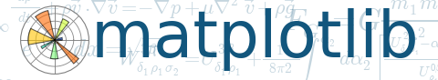

Methodology
Data Clean,
SQL Storage
&
Split
EDA
&
Feature Selection
Model Search
And
Evaluation
Final
Model
Selection
Model
Testing
Notes:
Methodology is straight forward.
In the Model Search and Evaluation step I used a grid search with cross validation taking care to make sure the ’optimal’ parameters were not at the extreme of the range of values tested.
You can see the tools I used in the project at the bottom.

Slide 5
Exploratory Data Analysis
Dataset contained 7,000 entries for Telecom Customers
Each entry had 20 features and churn outcome
27% of Customers Churned
Notes:
During the initial EDA I confirmed that this dataset was representative of current market conditions.
As you can see here, the churn rate is in line with industry estimates.

Slide 6

EDA - Features
17 Features we used for model fit
15 Features are Yes/No binary values
88% of customers who churn are on month to month contracts.
Notes:
Three features were dropped due to strong correlation with other features.
Month to month contracts.

Slide 7
Model Search
Models Tested
Logistic Regression
KNN Classifier
Random Forest Classifier
Support Vector Classifier
Naïve Bayes Classifier
Hybrid Model
Notes:
That brings us to the model search step.
As I mentioned, I used a grid search with cross validation for each candidate.
I evaluated Logistic Regression, …
You see at the bottom here something I call a Hybrid Model. Because so many of the churn customers were on month to month contracts I thought I might be able to improve model performance by dividing the dataset into a month-to-month contract group and a longer term contract group.
I followed the same grid search, cross validation procedure for each of these groups to identify the best models.
The Hybrid model was logistic regression for the month to month group and Random Forest for the longer term contracts.

Slide 8
Model Search
 | Metrics
Models Tested | Recall | ROC AUC Score
Logistic Regression
KNN Classifier
Random Forest Classifier
Support Vector Classifier
Naïve Bayes Classifier
Hybrid Model
Notes:
I used recall as my primary metric because losing customers to churn is theoretically more expensive than marketing expenses.
I also used the ROC-AUC chart.

Slide 9
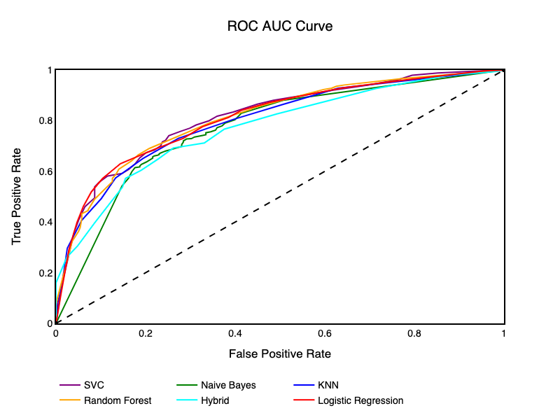
Model Search
 | Metrics
Models Tested | Recall | ROC AUC Score
Logistic Regression | 0.76 | 0.83
KNN Classifier | 0.75 | 0.81
Random Forest Classifier | 0.86 | 0.82
Support Vector Classifier | 0.78 | 0.82
Naïve Bayes Classifier | 0.78 | 0.77
Hybrid Model | 0.70 | 0.77
Notes:
Here are the results. PAUSE
As you can see, many of the models performed similarly.

Slide 10
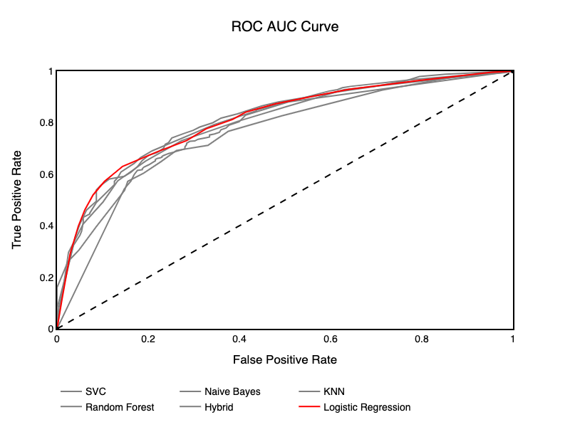
Model Search
 | Metrics
Models Tested | Recall | ROC AUC Score
Logistic Regression | 0.76 | 0.83
KNN Classifier | 0.75 | 0.81
Random Forest Classifier | 0.86 | 0.82
Support Vector Classifier | 0.78 | 0.82
Naïve Bayes Classifier | 0.78 | 0.77
Hybrid Model | 0.70 | 0.77
Notes:
I selected Logistic Regression for two reasons:
1. It is the most interpretable model
2. Looking at the ROC-AUC curve it appears to have the most consistent performance.

Slide 11
Final Testing Results
Scores with Test Data
ROC-AUC Score: 0.86
Recall Score: 0.54
Notes:
This brings us to final testing. Pause.
As you can see, the recall score dropped on the final test dataset.

Slide 12
Conclusions and Next Steps
Model Needs Improvement
Look for a broader feature set.
Consider ensembling models.
Reoptimize model using true business impact.
Notes:
It’s clear I need to improve the model with respect to recall
We might achieve this by using a richer feature set
And I can evaluate ensembling models
However, I think an further model refinement needs to consider promotional costs.

Slide 13
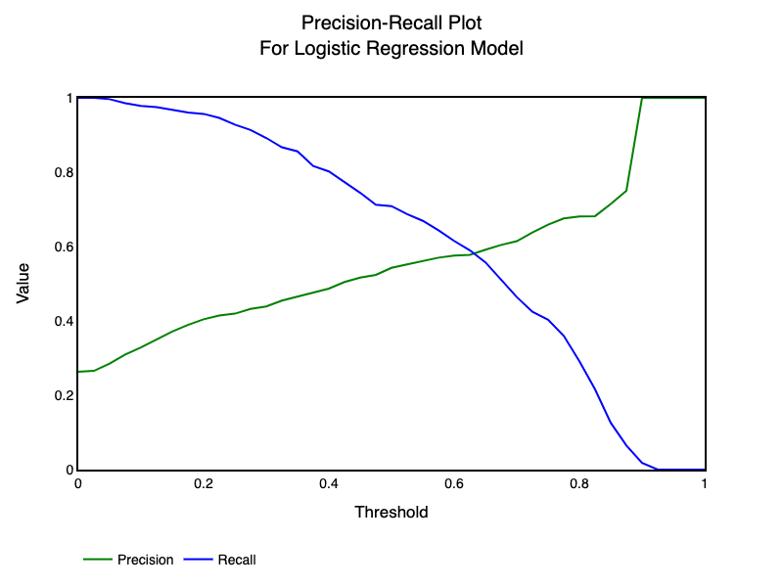
Notes:
As we build our model we can choose where we operate on these curves. Both come into play in as part of promotional costs.

Slide 14
Questions?

Slide 15
References:
1. http://www.dbmarketing.com/telecom/churnreduction.html
2. https://telecoms.com/opinion/churn-is-breaking-the-telecoms-market-heres-how-to-fix-it/

Slide 16
Appendix
Graphs I didn’t use in the presentation
Financial Analysis
Definitions of scoring metrics

Slide 17
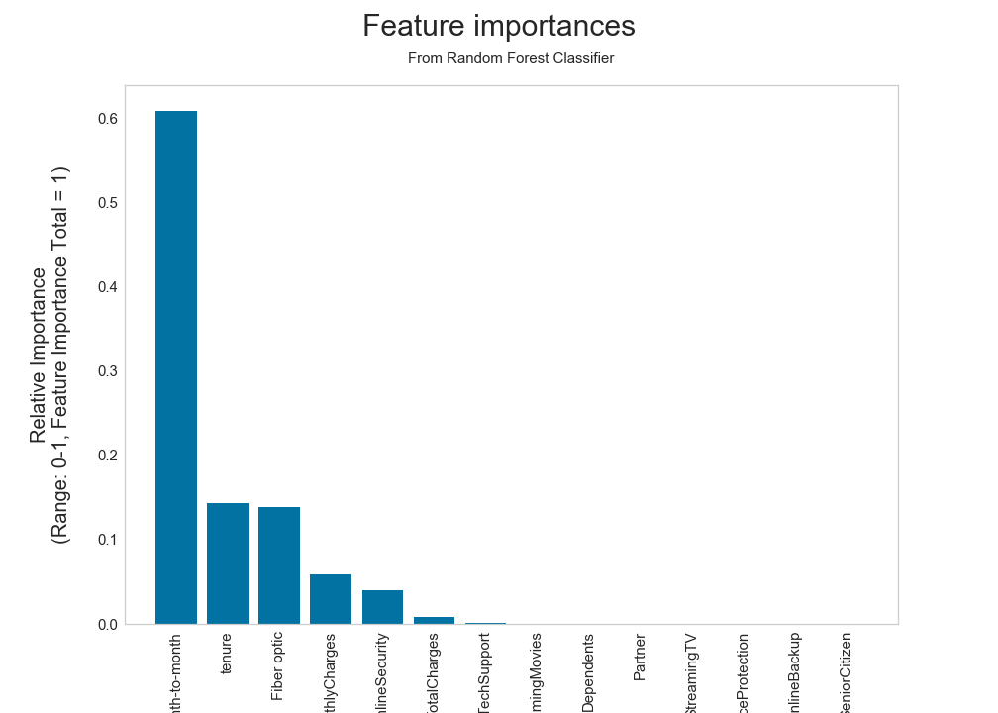

Slide 18
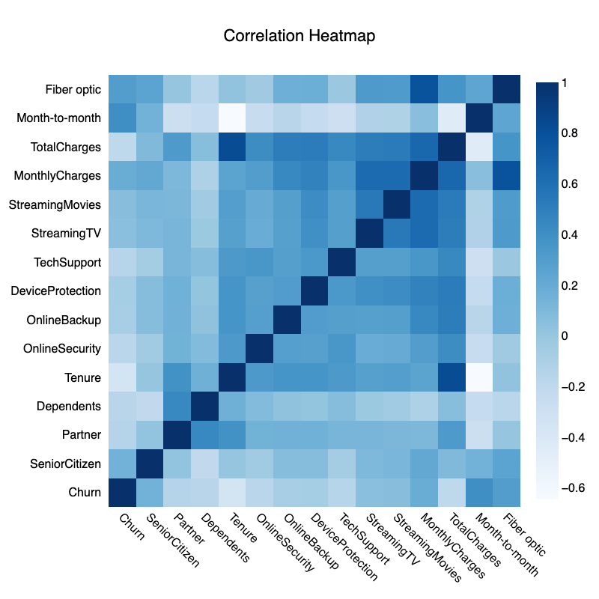
Features
Notes:
Quick discussion of the features:
I apologize in advance for showing this heat map but I wanted to point out a couple of things

Slide 19
Complete Test Results
 | Metrics
Models Tested | F1 | Recall | ROC AUC Score
Logistic Regression | 0.60 | 0.76 | 0.83
KNN Classifier | 0.53 | 0.75 | 0.81
Random Forest Classifier | 0.61 | 0.86 | 0.82
Support Vector Classifier | 0.63 | 0.78 | 0.82
Naïve Bayes Classifier | 0.59 | 0.78 | 0.77
Hybrid Model | 0.53 | 0.70 | 0.77

Slide 20
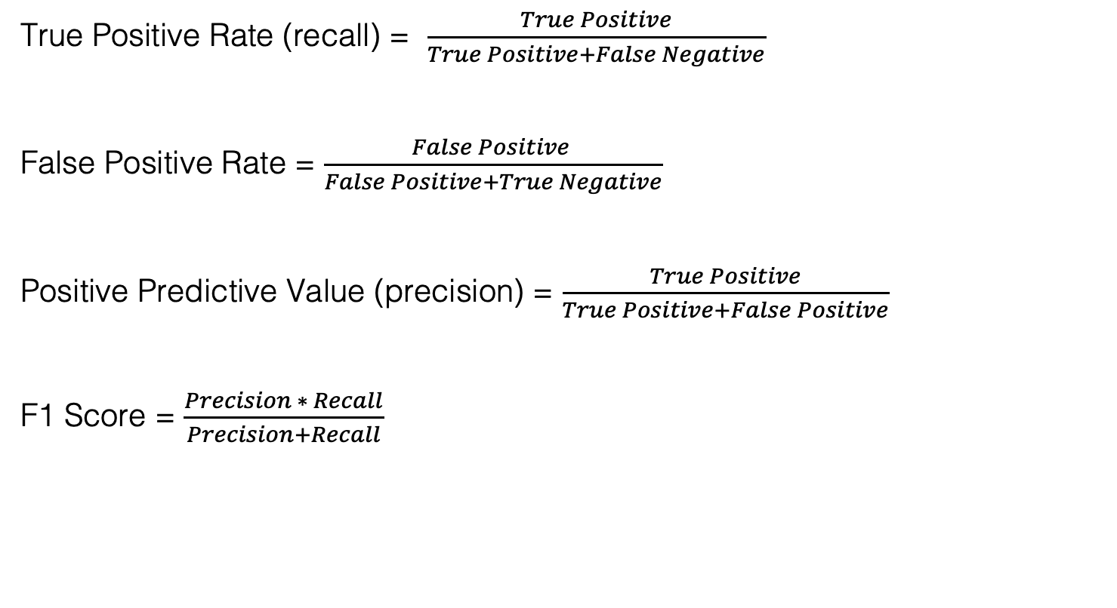
Model Scoring
True Positive Rate (recall) = $\frac{True Positive}{True Positive+False Negative}$
False Positive Rate = $\frac{False Positive }{False Positive+True Negative}$
Positive Predictive Value (precision) = $\frac{True Positive}{True Positive+False Positive}$
F1 Score = $\frac{Precision ∗ Recall}{Precision+Recall}$

Slide 21
Simulated Business Impact
Obviously doing nothing will mean significant loss of revenue for the company. Conversely, offering an incentive to all customers would result in unnecessary expenses for content customers. We need to find a happy middle ground.
At an average monthly charge of $64.76 regular churn translates to an annual loss of $121,036.
Building a financial model for an incentive plan might include a per customer incentive cost and an acceptance rate. The cost calculations are then:
Churn Reduction = Base Churn Rate * Recall * Acceptance Rate New Churn = Base Churn - Churn Reduction
= Base Churn (1 - Recall * Acceptance)
Incentive Cost = (tp + fp) / (tp + fp + fn + tn) * Acceptance Rate * Incentive Cost

Slide 22
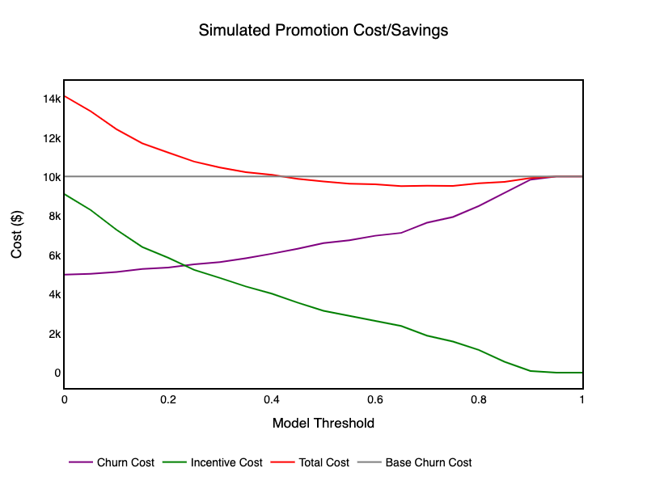
Plugging in promotion cost of 4% of monthly charges and an acceptance rate of 50 percent we get the following cost v model threshold graph.

